Slide 1

Half-Byte Solutions
Flextype emg keyboard

Slide 2
The Problem
Individuals with neurological disabilities have difficulty typing due to limited hand motion and motor control
There aren't many alternative solutions to traditional keyboards, and the ones available aren't effective for everyone
Anyone can become disabled in their hands and fingers due to age or disease
Many people facing this issue either rely on the help of others, or use Voice-to-Text to type. While these solutions work, they don't allow the user to have privacy or independence when typing.

Slide 3
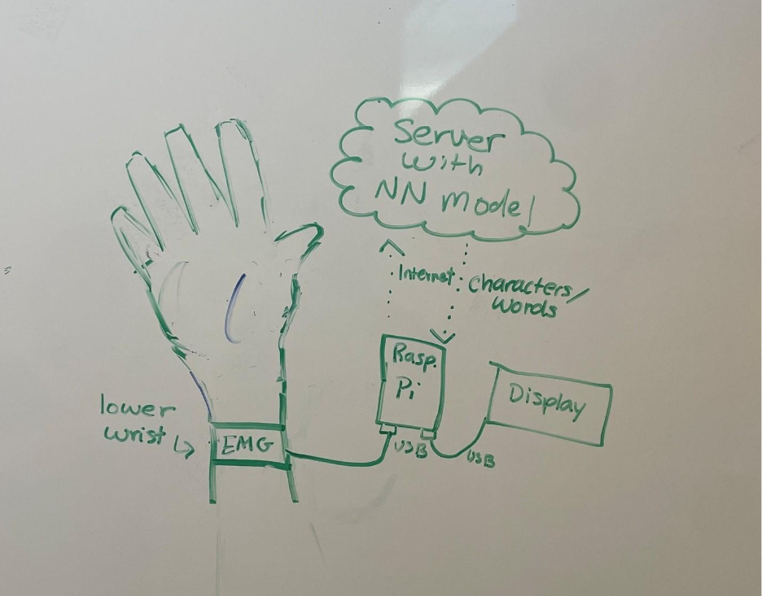
The Solution
A small, portable EMG device that picks up movements in the hand and uses them to type
Users learn 8-10 simple gestures for different sets of letters
The device connects to an AI model that understands the gesture being made, then sends the characters to a word prediction model that types out each word

Slide 4
Our Value Proposition
FlexType: Freedom to communicate!
FlexType EMG Gesture Keyboard is a wearable device that transforms muscle signals from the user's arm and hand into text, enabling people without fine motor control to communicate seamlessly through text without the need for keyboards or touchscreens. With the help of EMG and IMU sensors, FlexType reads gestures and uses a word prediction model to generate desired words or phrases with high accuracy

Slide 5
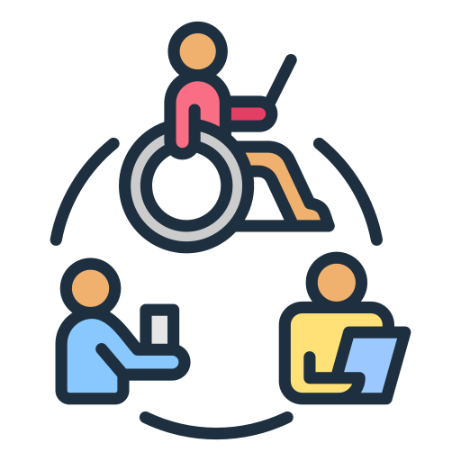
Target Market Size
The ideal customers would be individuals with limited hand and arm mobility which includes:
Neurologically Disabled, ~20-30 million
Elderly, ~20 million
Other customers include:
Visually Impaired Individuals, ~7 million (CDC)
People with missing fingers, 500 thousand (VA)
The total market size is around 50 – 60 million individuals
Gesture-Controlled Wearables Market: Projected to grow to $21.12 billion by 2034, per Market.us

Slide 6

Competition
Similar Products include:
Eye Tracking Keyboard
Voice-To-Text
Meta's EMG wristband (gestures to digital commands)
Our product is different because it can be used in quiet and loud environments.
It's confidential and easily portable.
Our product relies on a word prediction model, which could reduce typing time when typing messages
Our model is designed to be accessible for all kinds of people

Slide 7
Our "Secret Sauce"
The only mainstream solution right now is Voice-to-Text, which isn't very effective for people with Parkinson's or in certain environments
Most alternative keyboards only work for PCs and not for mobile phones, where they are needed more
The FlexType model is very new and ready to be expanded on for disabled users

Slide 8
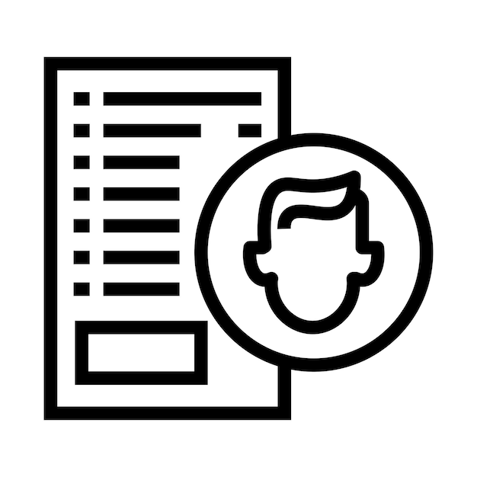
Customer Validation Data
Many people with Parkinson's Disease (PD) rely on the help of others to type, or do not type at all
It took 9 minutes for one person with PD to type 3 sentences with Voice-To-Text
People with PD often have issues with their vocal chords, limiting the usability of Voice-To-Text
Many alternative keyboards do not work with mobile phones, have low accuracy, or are not helpful for people with tremors

Slide 9
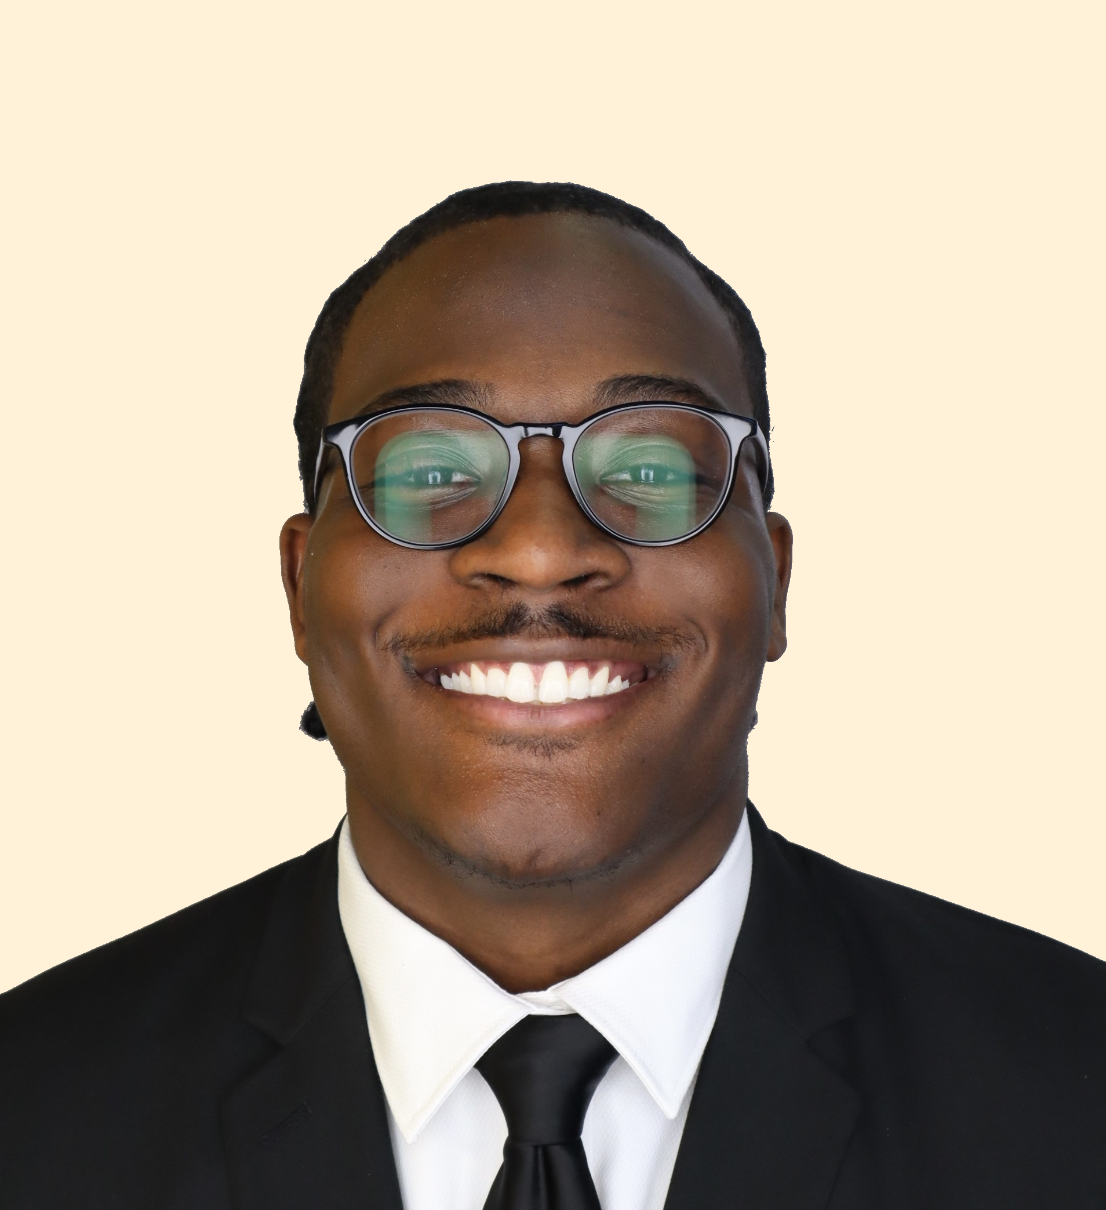
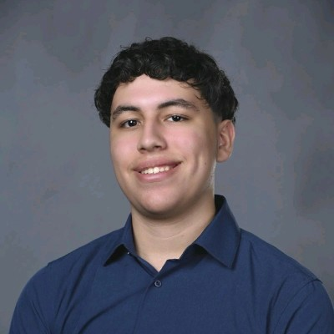

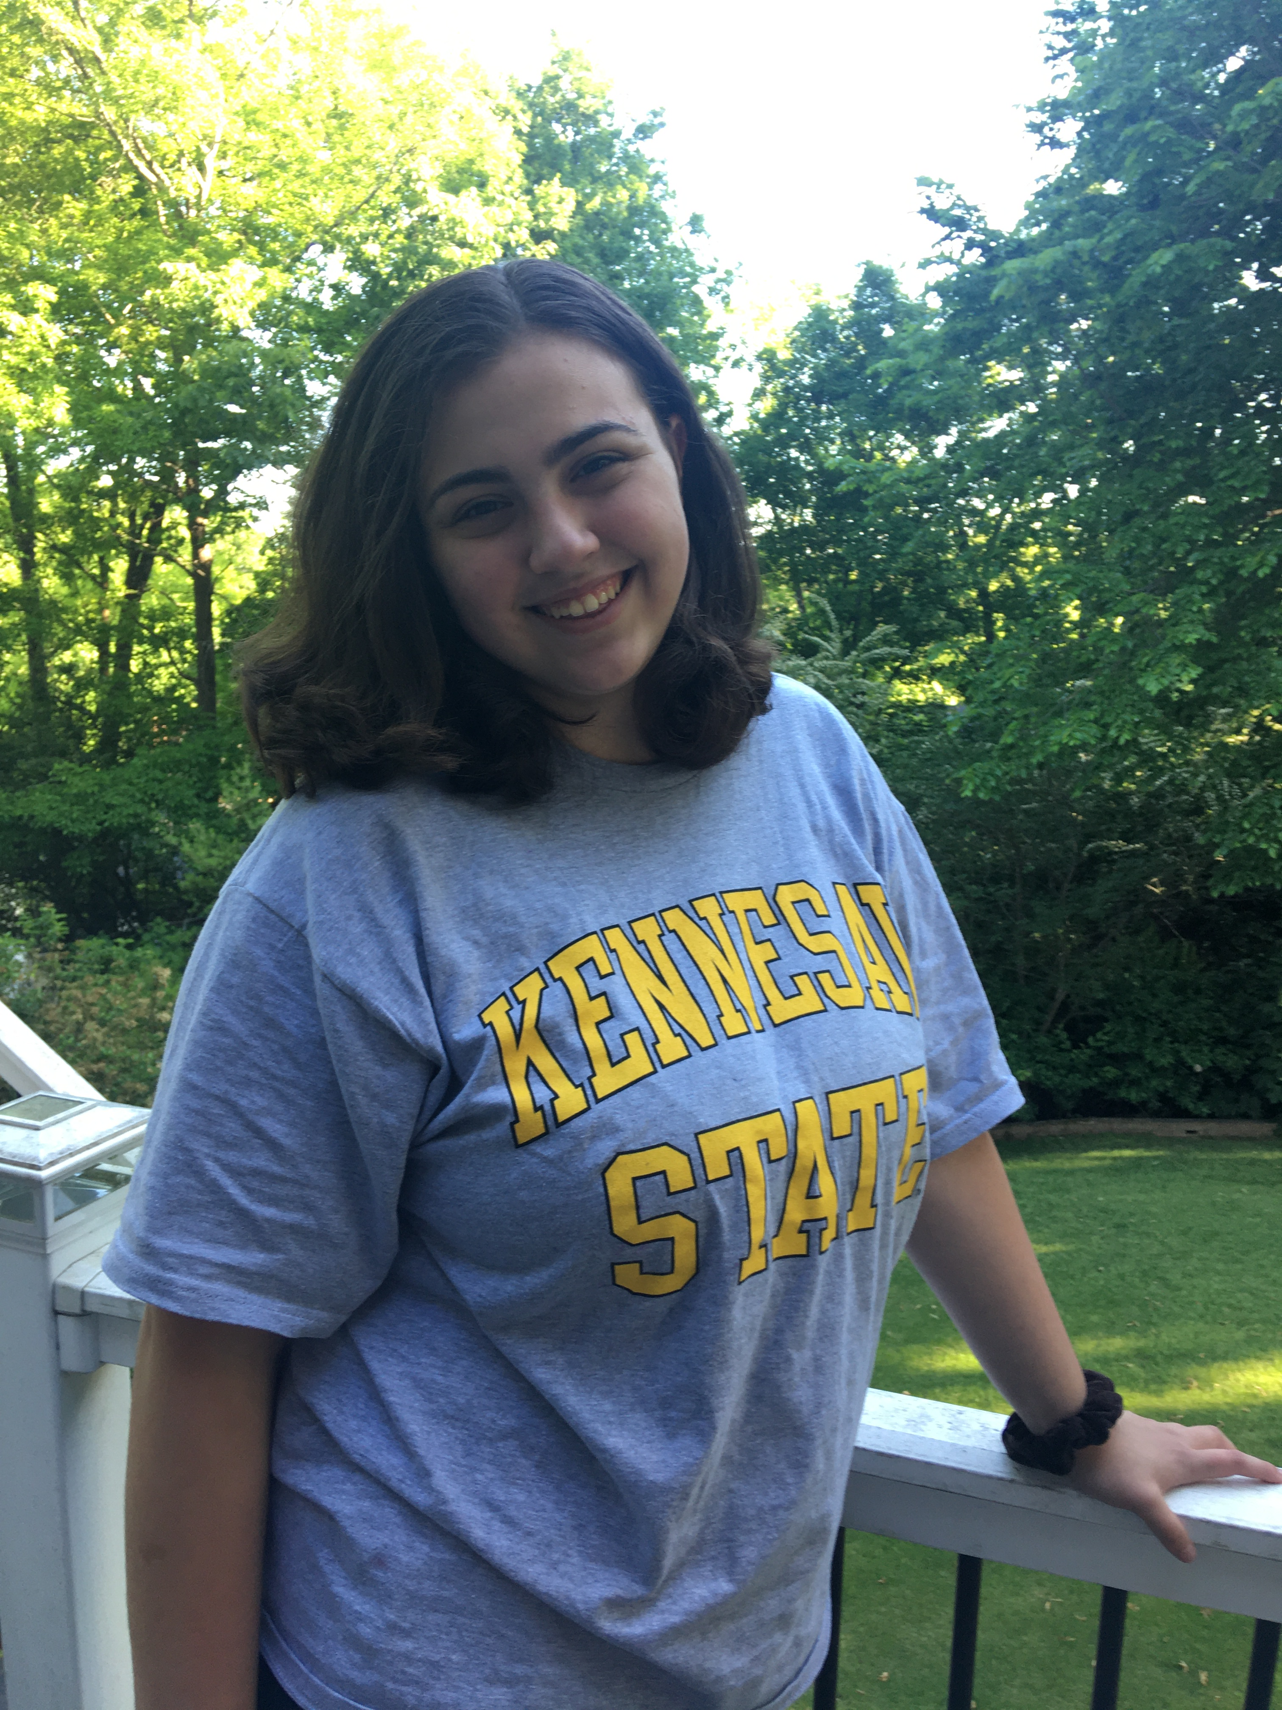
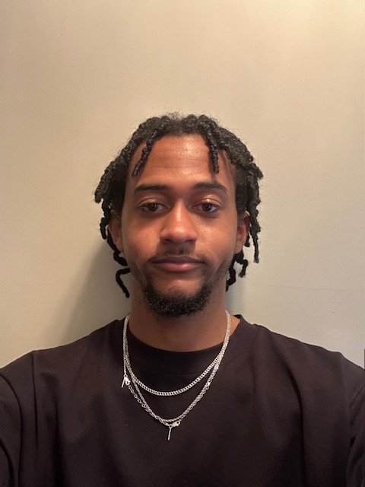
Our Team
Julia Johnson
Project Lead
Jalen Tottress
Giancarlos Hernandez
Kejon Ivery

